Slide 1

LAB 21
January 2025

Slide 2
CONTENTS
01
Synchronizing Processes with a Mailbox
02
Simulating the Mailbox Test Case
03
Achieved Outcomes
Testing the Register Design

Slide 3
Synchronizing Processes with a Mailbox
01

Slide 4




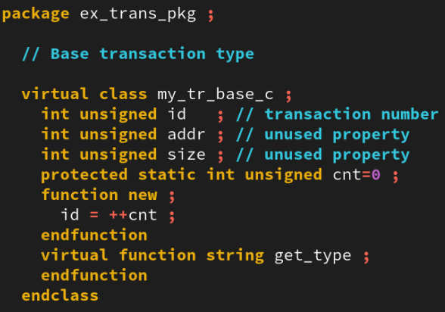
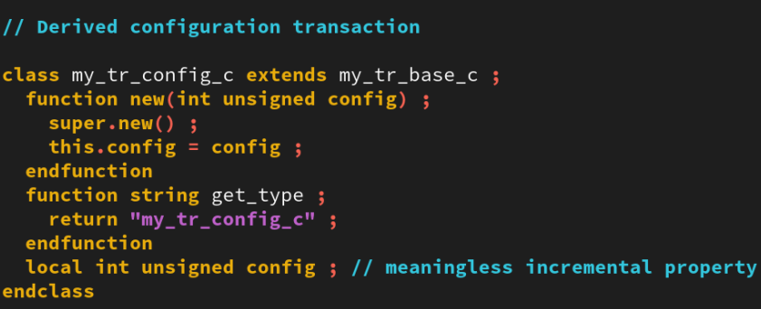
1. Synchronizing Processes with a Mailbox
01
Examining the Mailbox Test Case in the lab21-mailbox directory.
Examine the transaction classes defined in the ex_trans_pkg package in the ex_trans_pkg.sv file:
The my_tr_base_c class provides a base class that other transaction types extend. The base class has an “id” field and a virtual get_type() method.
The my_tr_config_c, my_tr_synch_c and my_tr_comms_c classes extend the my_tr_base_c class. The only important thing that they do is re-implement the get_type() method.
ex_trans_pkg.sv
Notes:
IC: Integrated Circuit

Slide 5
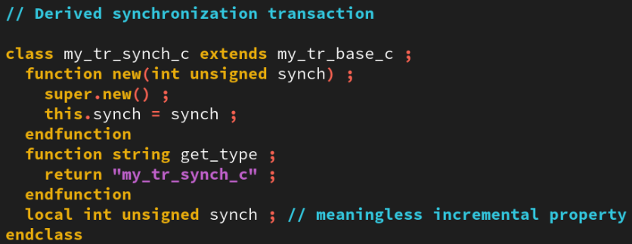
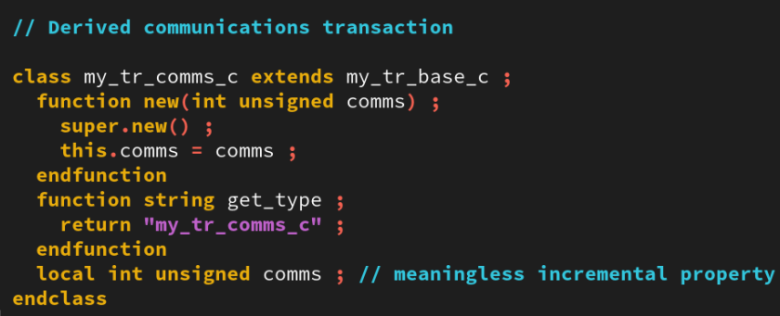
1. Synchronizing Processes with a Mailbox
01
ex_trans_pkg.sv
Notes:
IC: Integrated Circuit

Slide 6
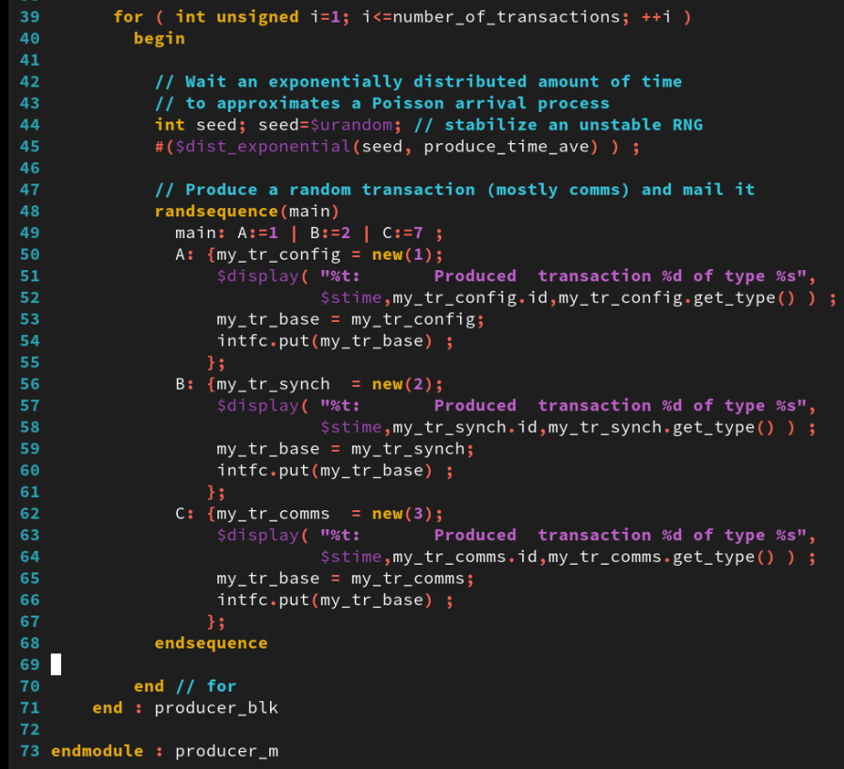
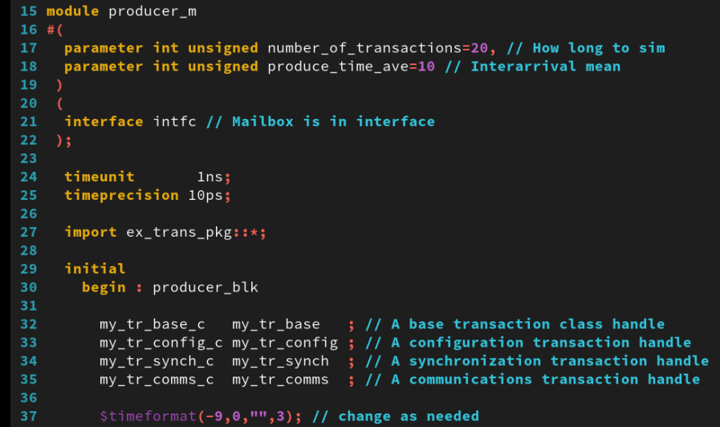
1. Synchronizing Processes with a Mailbox
01
Examine the mailbox_producer_m module in the mailbox_producer_m.sv file:
This unit randomly produces transactions and calls interface methods to put the transactions into the interface mailbox.
It produces transactions at exponentially distributed intervals to mimic a classic Poisson arrival process.
The transactions are weighted as follows: 10% my_tr_config_c, 20% my_tr_synch_c and 70% my_tr_comms_c.
mailbox_producer_m.sv
Notes:
IC: Integrated Circuit

Slide 7
1. Synchronizing Processes with a Mailbox
01
Examining the Mailbox Test Case in the lab21-mailbox directory.
Examine the mailbox_consumer_m module in the mailbox_consumer_m.sv file:
This unit calls interface methods to get transactions from the interface mailbox and separately queues each transaction type for its consumption process.
It uses mailbox queues because the SystemVerilog queue has no blocking put() and get() methods.
The service time is a uniform distribution that is the same for all transaction types. Depending upon what system you model, you might want to alternatively consider exponential or normal distributions of service time.
Producer
top
producer Mailbox consumer
Interface
Notes:
IC: Integrated Circuit

Slide 8
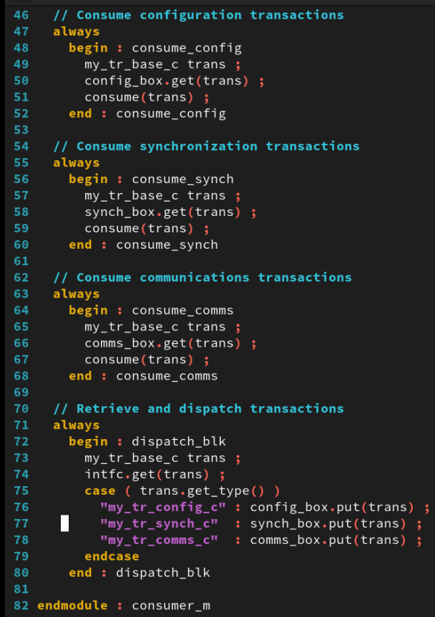
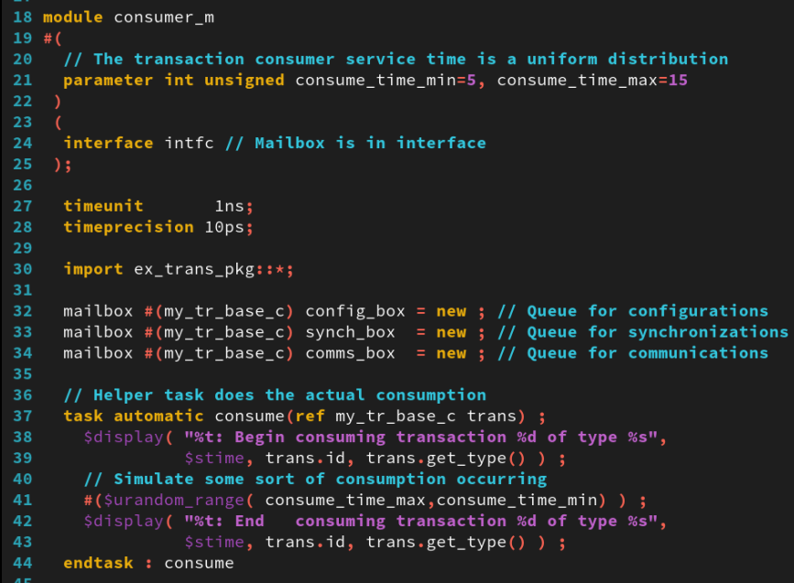
1. Synchronizing Processes with a Mailbox
01
mailbox_consumer_m.sv
Notes:
IC: Integrated Circuit

Slide 9
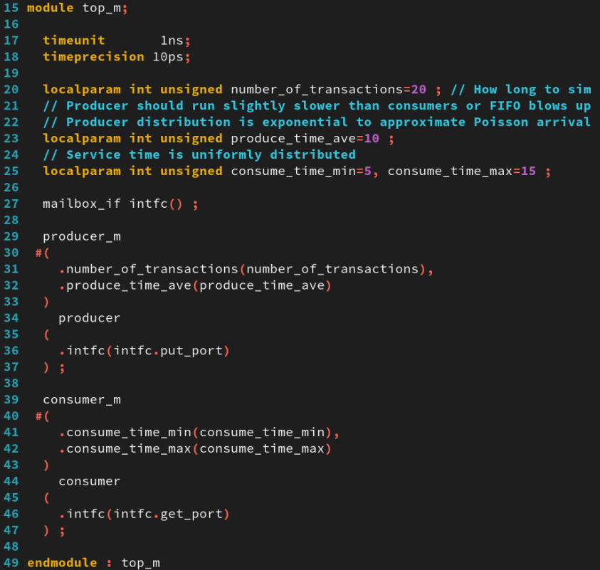
1. Synchronizing Processes with a Mailbox
01
Examining the Mailbox Test Case in the lab21-mailbox directory.
Examine the mailbox_top_m module in the mailbox_top_m.sv file:
Examine the mailbox_top_m module in the mailbox_top_m.sv file:
mailbox_top_m.sv
Notes:
IC: Integrated Circuit

Slide 10
1. Synchronizing Processes with a Mailbox
01
Examining the Mailbox Test Case in the lab21-mailbox directory.
Examine the mailbox_if interface in the mailbox_if.sv file:
This unit declares a mailbox and duplicates the mailbox access methods. Wrapping an interface around a mailbox allows you to access the mailbox through ports and using hierarchical references.
This file is incomplete and you will complete it in the lab.
Complete the mailbox_if.sv file according to the commented instructions to declare a mailbox and complete the set of mailbox access routines.
Notes:
IC: Integrated Circuit

Slide 11
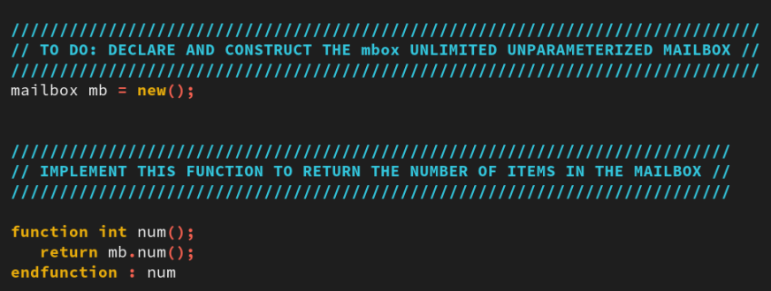
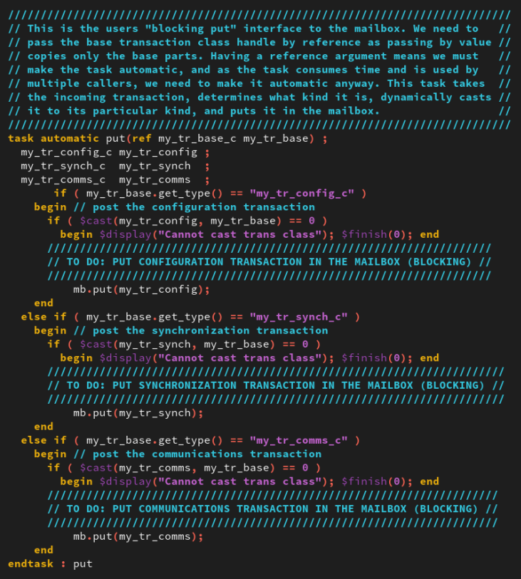
1. Synchronizing Processes with a Mailbox
01
mailbox_if.sv
Notes:
IC: Integrated Circuit

Slide 12
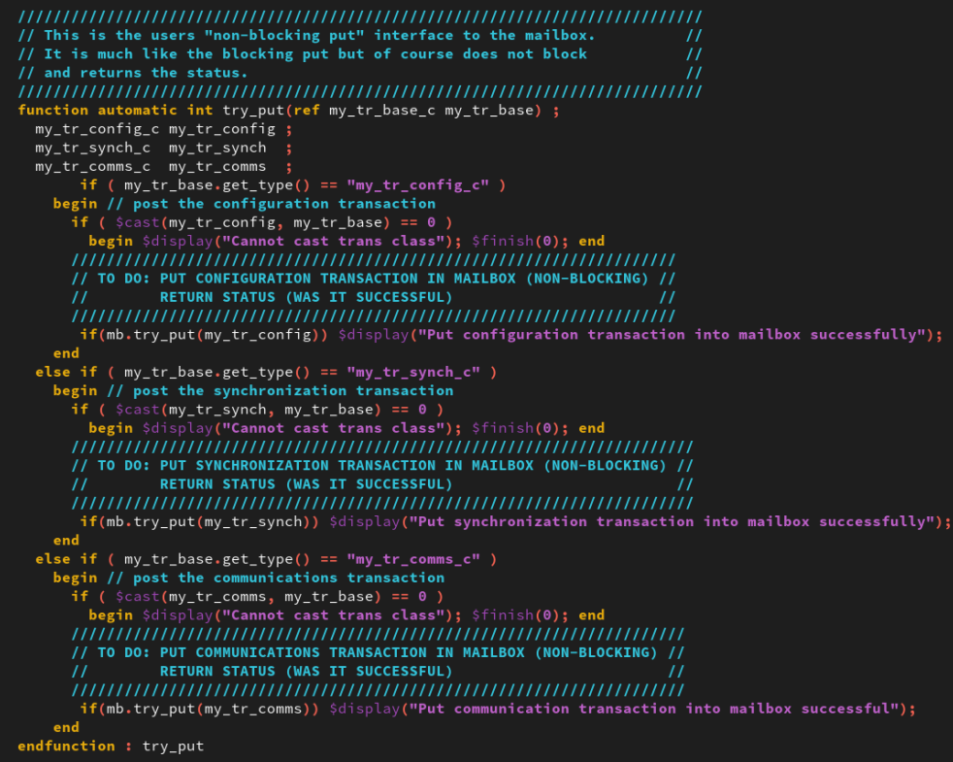
1. Synchronizing Processes with a Mailbox
01
mailbox_if.sv
Notes:
IC: Integrated Circuit

Slide 13
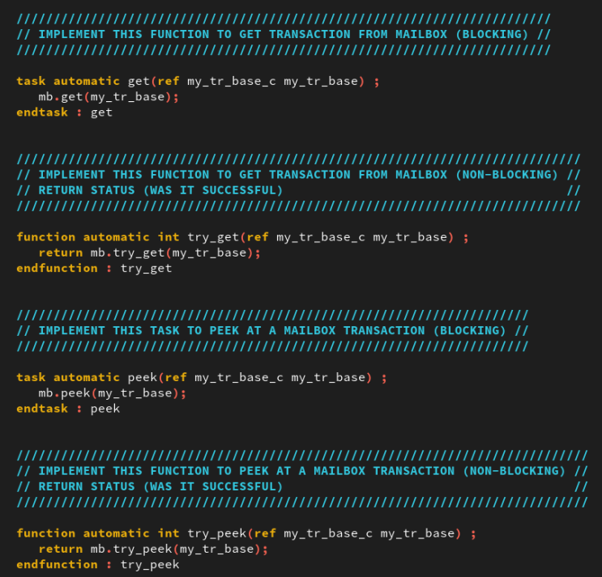
1. Synchronizing Processes with a Mailbox
01
mailbox_if.sv
Notes:
IC: Integrated Circuit

Slide 14
Simulating the Mailbox Test Case
02

Slide 15
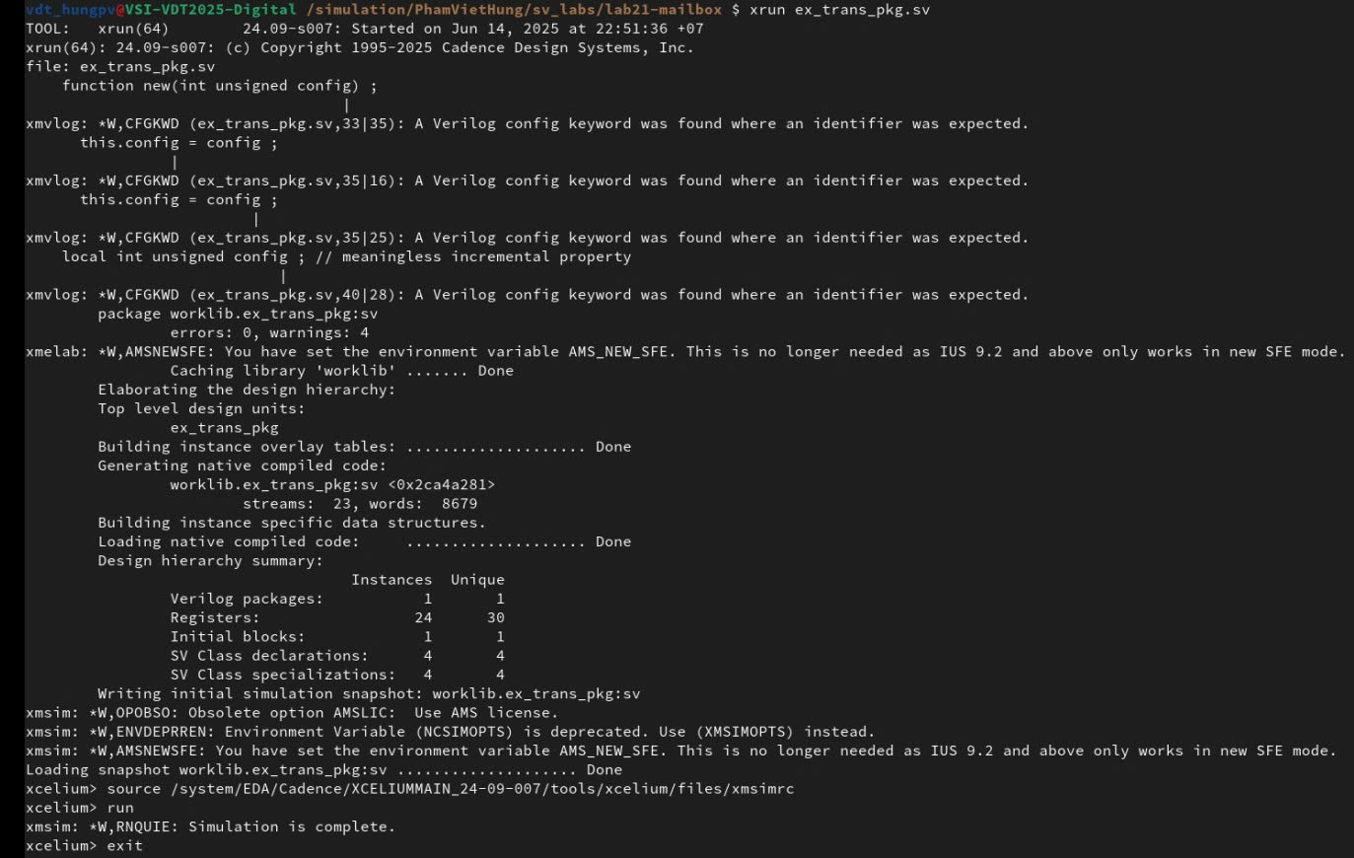
2. Simulating the Mailbox Test Case
01
Run command: xrun ex_trans_pkg.sv
The result as below:
Notes:
IC: Integrated Circuit

Slide 16
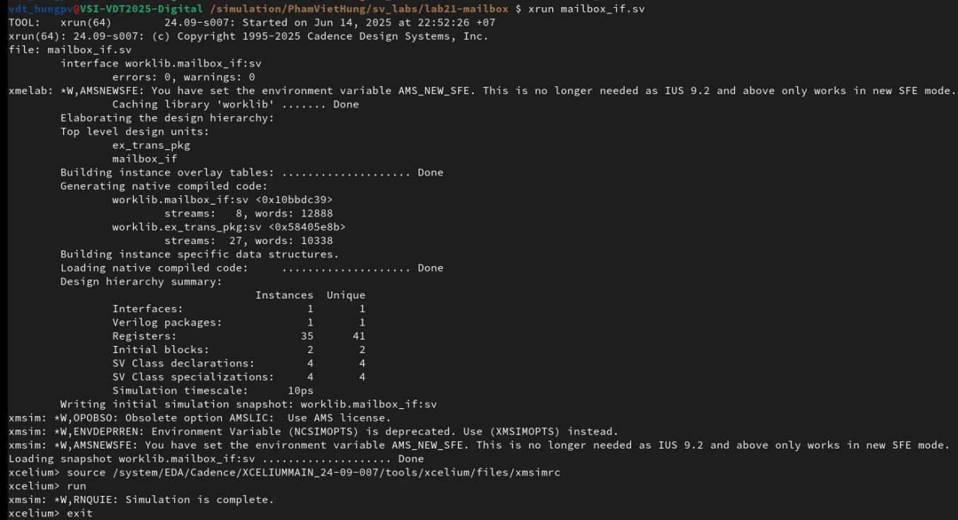
2. Simulating the Mailbox Test Case
01
Run command: xrun mailbox_if.sv
The result as below:
Notes:
IC: Integrated Circuit

Slide 17
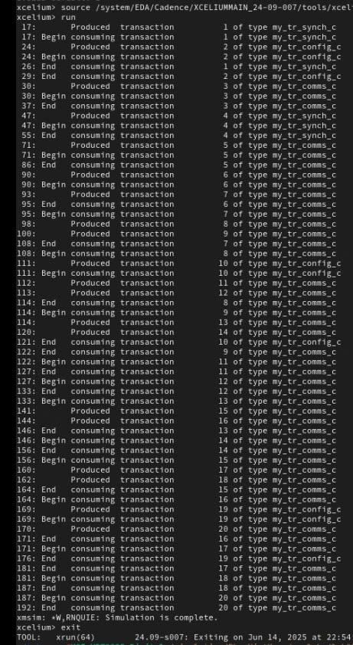
2. Simulating the Mailbox Test Case
01
Run command: xrun ex_trans_pkg.sv mailbox_consumer_m.sv mailbox_if.sv mailbox_producer_m.sv mailbox_top_m.sv
The result as below:
Notes:
IC: Integrated Circuit

Slide 18
Achieved Outcomes.
03

Slide 19
3. Achieved Outcomes
01
Understand the specification and to use a mailbox to synchronize the communication of transactions between processes.
This lab provides a system in which a producer mails transactions to a consumer.
Notes:
IC: Integrated Circuit

Slide 20

THANK YOU!

